Slide 1
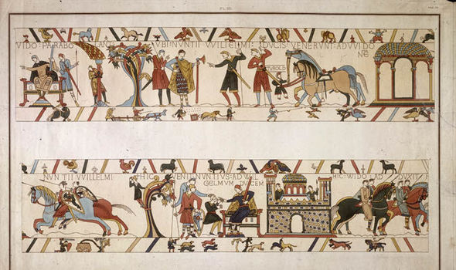
WCSA
History
Home Learning Book –Learning Cycle 1
Year 7
The Bayeux Tapestry
of my Life
Name:_______________________ Tutor Group;_______
History Teacher(s):_____________________________________

Slide 2
Cycle 1 Calendar - Homework
Sep 2018 | 1.1 | 3 | 4 | 5 | 6 | 7
 | 1.1 | 10 | 11 | 12 | 13 | 14 | W1
 | 1.2 | 17 | 18 | 19 | 20 | 21 | W2
 | 1.3 | 24 | 25 | 26 | 27 | 28 | W3
Oct 2018 | 1.4 | 1 | 2 | 3 | 4 | 5 | W4
 | 1.5 | 8 | 9 | 10 | 11 | 12 | W5
 | 1.6 | 15 | 16 | 17 | 18 | 19 | W6
 |  | 22 | 23 | 24 | 25 | 26 | 1/2 term
 |  | 29 | 30 | 31 | 1 | 2 | 1/2 term
Nov 2018 | 1.7 | 5 | 6 | 7 | 8 | 9 | W7
 | 1.8 | 12 | 13 | 14 | 15 | 16 | Assessment
 | 1.9 | 19 | 20 | 21 | 22 | 23 | STW

Slide 3
Why is regular home learning important?
It can improve a student’s thinking and memory skills. This is vital for the new content heavy GCSEs.
It helps students to develop positive study skills and habits that will serve them well throughout life.
Home learning encourages students to use time wisely and efficiently.
It teaches students to work independently.
Home learning teaches students to take responsibility for their own work.
It allows students to review and practice what has been covered in class and consolidate their knowledge and skills.
Equally important, it helps students to get ready for the next day’s class.
It helps students learn to use resources, such as libraries, reference materials, and computer Web sites to find information.
It encourages students to explore subjects more fully than classroom time permits.
It allows students to extend their learning by applying skills to new situations.
Home learning helps parents learn more about what their children learning in school.

Slide 4
As part of your homework you will be creating your very own Bayeux Tapestry about your life. You will need to draw and explain your Bayeux Tapestry and highlight aspects of your life to be studied in the future.
Be creative
Have fun
Tell your story!
Week 1 : Research activity
Before we start we need to do our research : When, why, who, where, what? Using the internet or books complete a mini mind map.
Use the key words: Bayeux Tapestry in the search box
What does it contain?
When was it made?
The Bayeux Tapestry
Why was it made?
Who made it?
Who had it made?
How long did it take?
Where was it made?
What is it made of?
Checked by: Date:

Slide 5
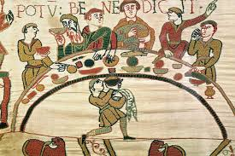
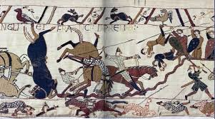
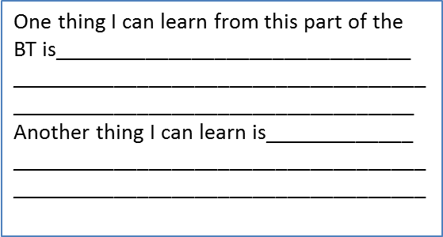
Week: 2 Studying a section of The Bayeux Tapestry.
Task: Examine these pieces of the tapestry very carefully . These are 2 sections of the Bayeux tapestry, what can you learn from each one about life in the medieval times.
Circle and note what type of activities you can see from both sections of the BT
Complete: 2 things you have learned about Medieval life. (BT: Bayeux Tapestry)
One thing I can learn from this part of the BT is_______________________________
_______________________________________________________________________
Another thing I can learn is_____________
________________________________________________________________________
Checked by________________ Date_______________

Slide 6
Week: 3 Getting started.
My Bayeux Tapestry of my Life
You will be creating 4 sections and writing up an explanation for each section.
Sections:
Family time and members
school and friends
activities: sports /hobbies you enjoy
Holidays, day trips you have been on.
Section 1:_____________________________
_________________________________________________________________________________________________________________________________________________________________________________________________________________________________________________________________________________________________________________________________________________________________________________________________

Slide 7
Week: 4 Time to create.
My Bayeux Tapestry of my Life
You will be creating 4 sections and writing up an explanation for each section.
Sections:
Family time and members
school and friends
activities: sports /hobbies you enjoy
Holidays, day trips you have been on.
Section 2___________________________________________
__________________________________________________________________________________________________________________________________________________________________________________________________________________________________________________________________________________________________________________________________________

Slide 8
Week: 5 More to create.
My Bayeux Tapestry of my Life
You will be creating 4 sections and writing up an explanation for each section.
Sections:
Family time and members
school and friends
activities: sports /hobbies you enjoy
Holidays, day trips you have been on.
Section 3__________________________________________
_________________________________________________________________________________________________________________________________________________________________________________________________________________________________________________________________________________________________________________________________________________________________________________________________

Slide 9
Week: 6 The final piece.
My Bayeux Tapestry of my Life
You will be creating 4 sections and writing up an explanation for each section.
Sections:
Family time and members
school and friends
activities: sports /hobbies you enjoy
Holidays, day trips you have been on.
Section 4____________________________________________________
_________________________________________________________________________________________________________________________________________________________________________________________________________________________________________________________________________________________________________________________________________________________________________________________________

Slide 10
Week: 7 End of topic revision
Glue in your work sheet here:
Choose 3 activities to complete from the table above.
You must do the box in the centre first
you can go across or diagonally across.. You decide!
Use the following pages to complete your work and put any additional paper inside your booklet

Slide 11
________________________________________________________________________________________________________________________________________________________________________________________________________________________________________________________________________________________________________________________________________________________________________________________________________________________________________________________________________________________________________________________________________________________________________________________________________________________________________________________________________________________________________________________________________________________________________________________________________________________________________________________________________________________________________________________________________________________________________________________________________________________________________________________________________________________________________________________________________________________________________________________________________________________________________________________________________________________________________________________________________________________________________________________________________________________________________________________________________________________________________________________________________________________________________________________________________________________________________________________________________________________________________________________________________________________________________________________________________________________________

