Slide 1
WCSA
Religious Studies
Home Learning Booklet Learning Cycle 2 Y9
Tackling controversial issues
Name: _______________________________Tutor Group: 9___
Target Grade:________ Class: 9_________
Teacher: ___________________________________

Slide 2
Racism …. p4 Week Due: 1 Islamophobia… p6 Week Due: 2 Key words… p7 Week Due: 3 Islam and Women … p8 Week Due: 4 Assessment prep… p9 Week Due: 5 Jihad…… p10 Week Due: 6 9/11 …… p11 Week Due: 7 Revision…… p12 Week Due: 8
Contents
November | 25 | 26 | 27 | 28 | 29 | Teaching week 1
December | 2 | 3 | 4 | 5 | 6 | Teaching week 2
 | 9 | 10 | 11 | 12 | 13 | Teaching week 3
 | 16 | 17 | 18 | 19 | 20 | Teaching week 4
 | 23 | 24 | 25 | 26 | 27 | Christmas Break
 | 30 | 31 | 1 | 2 | 3 | Christmas Break
January | 6 | 7 | 8 | 9 | 10 | Teaching week 5
 | 13 | 14 | 15 | 16 | 17 | Teaching week 6
 | 20 | 21 | 22 | 23 | 24 | Teaching week 7
 | 27 | 28 | 29 | 30 | 31 | Assessment Week
February | 3 | 4 | 5 | 6 | 7 | Super Teach Week

Slide 3
Why is regular home learning important?
It can improve a student’s thinking and memory skills. This is vital for the new content heavy GCSEs.
It helps students to develop positive study skills and habits that will serve them well throughout life.
Home learning encourages students to use time wisely and efficiently.
It teaches students to work independently.
Home learning teaches students to take responsibility for their own work.
It allows students to review and practice what has been covered in class and consolidate their knowledge and skills.
Equally important, it helps students to get ready for the next day’s class.
It helps students learn to use resources, such as libraries, reference materials, and computer Web sites to find information.
It encourages students to explore subjects more fully than classroom time permits.
It allows students to extend their learning by applying skills to new situations.
Home learning helps parents learn more about what their children learning in school.
It allows parents to communicate with teachers about learning in order to support their children efficiently.

Slide 4
Week 1 Racism – The story of Emmett Till
In preparation for out topic on tackling controversial issues and our first lesson on racism, read through the summary of what happened to Emmett Till during segregation. Below answer the couple of questions and then write about your response to this. Feel free to do extra research if you want to know more.
In August 1955, Emmett Till, a black teenager from Chicago, was visiting relatives in Mississippi when he stopped at Bryant’s Grocery and Meat Market. There he encountered Carolyn Bryant, a white woman. Whether Till really flirted with Bryant or whistled at her isn’t known. But what happened four days later is. Bryant’s husband Roy and his half brother, J.W. Milam, seized the 14-year-old from his great-uncle’s house. The pair then beat Till, shot him, and strung barbed wire and a 75-pound metal fan around his neck and dumped the lifeless body in the Tallahatchie River. A white jury quickly acquitted the men, with one juror saying it had taken so long only because they had to break to drink some pop. When Till’s mother Mamie came to identify her son, she told the funeral director, “Let the people see what I’ve seen.” She brought him home to Chicago and insisted on an open casket. Tens of thousands filed past Till’s remains, but it was the publication of the searing funeral image in Jet, with a stoic Mamie gazing at her murdered child’s ravaged body, that forced the world to reckon with the brutality of American racism. For almost a century, African Americans were lynched with regularity and impunity. Now, thanks to a mother’s determination to expose the barbarousness of the crime, the public could no longer pretend to ignore what they couldn’t see.
Why was Emmett Till killed?
_______________________________________________________________________
What punishment did his murderers receive?
_______________________________________________________________________
How did his mum ensure the story was heard?
_______________________________________________________________________
_______________________________________________________________________
What is your reaction to this story?
_______________________________________________________________________
_______________________________________________________________________
_______________________________________________________________________
_______________________________________________________________________
_______________________________________________________________________
_______________________________________________________________________

Slide 5
Week 2 - Islamophobia
This week we are looking at Islamophobia. Read the extract from the Telegraph article published on Sunday 13th October titled - Islamophobic Britain: Where Muslim women are spat on, punched and covered in faeces. Answer the questions at the end.
“I’ve been spat on in the street when I’ve worn my headscarf,” Sara Khan tells me.
“I’ve been called ‘Osama Bin Laden’s wife’. I’ve had people come right up to my face effing and blinding – even when I was pushing my six-month-old daughter in her pram".
Khan, who heads up anti-extremist organisation Inspire, is a female victim of Islamophobia in Britain.
“It’s shocking. You’re just minding your own business. It’s completely unprovoked," she adds. "It tends to happen after a terrorist incident, and you think, 'what have I done?' You feel angry you’re being associated with terrorists and extremists, but you also feel sad. It’s very dehumanising.”
Khan also tells me about one friend who had dog faeces put on her head, and another who was waiting at a bus stop, listening to her iPod and wearing a headscarf, when a man suddenly punched her. She was left with a black eye.
These are not isolated incidents. The Metropolitan Police has just released new statistics showing anti-Muslim hate crimes in Britain have risen by 70 per cent in the past year.
Tell Mama, an organisation that monitors Islamophobic attacks, says 60 per cent are directed at women, and happen on the street - as opposed to online.
Founder Fiyaz Mughal explains: “It’s because the more physical, abusive ones [attacks] are directed at visibility - which means the hijab (headscarf) and the niqab (full-face veil).”
Give two examples of discrimination the women have experienced.
_______________________________________________________________________
How much has anti-Muslim hate crime risen in the last year?
_______________________________________________________________________
Do attacks happen mostly online or in person?
_______________________________________________________________________
What is your reaction to this story?
_______________________________________________________________________
_______________________________________________________________________
_______________________________________________________________________
_______________________________________________________________________
_______________________________________________________________________
_______________________________________________________________________

Slide 6
Week 3 - Key word practice: Look, cover, write, check!
Keyterm | Definition | Attempt 1 definition | Attempt 2 definition
Racism | Discrimination based on race or ethnicity.
Islamaphobia | Fear of Islam
Niqab | Full-face veil worn by some Muslim women.
Hijab | Head scarf worn by some Muslim women.
Terrorism | Acts of violence, usually aimed at civilians for a political aim.
Greater Jihad | An internal struggle that impacts someone's faith
Lesser Jihad | An outward struggle to defend faith or family.
Ummah | The community of Muslims.
Holy War | A war fought for a religious purpose or goal.
Qu’ran | Holy book of Islam.

Slide 7
Week 4 – Women and the head scarf
Watch the video by following this link and answer the following questions. tiny.cc/13mhez
What does the term hijab mean?
___________________________________________________
What may men wear when praying?
___________________________________________________
How does wearing a headscarf show she is proud of being Muslim? Give 3 reasons.
1 _________________________________________________
2 _________________________________________________
3 _________________________________________________
What is your view on Muslim women wearing a Hijab?
___________________________________________________
___________________________________________________
Teacher Signature:_______________________________________

Slide 8
Week 5 – Assessment prep
Your assessment for this topic is about whether Islam treats women fairly.
Colour code the points and quotes below as equal or unequal. If the suggest men and women are equal put the as equal.
“The believers, men and women, are allies of one another. They enjoin the ‘common good’ and forbid the bad, they observe prayers and give charity and obey God and his Prophet”; Qur’an, 9:71
However, although men and women are equal, they are not the same. They have different purposes. It is part of Allah’s design and purpose for men and women to have different physical characteristics.
Muslims also believe that it is the duty of a man to provide for the financial needs of his family, and for a woman to look after the home and family.
Muslim women may attend the mosque but traditionally pray separately from men, either in a separate room or in a balcony so that men may not see them. Prayer is too important for people to be distracted so men and women have to pray Salat prayer in separate places.
In a mosque, prayer is led by an imam, and traditionally imams have always been male.
The Prophet Muhammad stressed the importance of women and the respect that should be shown to them when he said:
“Paradise lies at the feet of your mother.”
There is much discussion about the different dress rules regarding men and women. One viewpoint is that the different requirements over dress between men and women may lead to some prejudice and discrimination.
Many Muslim women wear a hijab or veil to protect their modesty. Not all Muslim women choose to do this. In the UK this is matter of choice and there is much discussion about the significance of wearing the hijab in British society.
Some Muslim women wear a niqab or a burkha. Not all Muslim women choose to do this. In the UK this is a matter of choice.
Men have no requirement to dress in this way but men are required to be modest in the way they dress.
Some Muslim women believe that the wearing of special garments, like the burkha, is a way of protecting themselves from what they see as an over-sexualised society. There may be a feeling that society portrays women as 'sex objects' and places too much importance on a woman's physical appearance. The wearing of the burkha is a practical expression of modesty in public.
Some Islamic states enforce the wearing of religious garments like the hijab, the headscarf which covers a woman's head. In these countries a number of women have been attacked for not wearing the hijab.
Teacher Signature:_______________________________________

Slide 9
Week 6 Jihad
This week you are looking at one of the 10 obligatory acts of Shia Muslims – Jihad.
This word means struggle and for Muslims there are two types of Jihad.
Greater Jihad – Internal struggle linked to faith
Lesser Jihad – Outward struggle to defend faith and family.
Research and find 3 examples of each type of Jihad
You can use this website if you need help https://www.bbc.co.uk/bitesize/guides/zhbpfcw/revision/6
Greater Jihad
1
2
3
Lesser Jihad
1
2
3
Teacher Signature:_______________________________________
Notes:
Some people believe that only their god is the correct one. Some people believe that all gods are false and do not exist. Other people believe they are all true and all different ways to understand one thing.
About God Hindus believe that there is one eternal force called Brahman. To help Christians to understand Brahman he is represented as lots of different gods with different qualities.
Jews believe there is only one God. They called God Yahweh. They will worship Yahweh and want to have relationship with him.
Christians believe that there is only one God but that God is 3 different Persons. This belief is called the Trinity. Christians believe in the Father, the Son, who is called Jesus, and the Holy Spirit.
Muslims call God Allah. Muslims believe that there is only one God. He is not divided in any way and does not show himself in any different forms. He is one. This belief in one God is called tawhid.
Sikh believe in one supreme God called Waheguru which means supreme teacher. Waheguru can help to guide Sikhs.
Buddhists do not believe in an omnipotent God who watches over them. They do believe that there are gods in the many Buddhist heavens but they are just reincarnations of people.

Slide 10
Week 7 – Exam style question
In RS you have a variety of question types. One is a 4 mark explain question. These will start Explain 2 and then say either similar or contrasting. Contrasting just means different.
These require 2 developed points for each question. Have a go at the one below – You could talk about lesser Jihad for one view and greater Jihad for another.
Explain two contrasting Muslim views about Jihad.
_______________________________________________________________________________________
_______________________________________________________________________________________
_______________________________________________________________________________________
_______________________________________________________________________________________
_______________________________________________________________________________________
_______________________________________________________________________________________
_______________________________________________________________________________________
_______________________________________________________________________________________
_______________________________________________________________________________________
_______________________________________________________________________________________
Description | Awarded
Describe arguments for or against
Describe arguments for and against
Explain arguments for and against
Explain arguments in detail
Some people believe Jihad is about internal struggles …
An example of this may be …
However, some say it is linked to an external struggle …
This is where …
Teacher Signature:_______________________________________

Slide 11
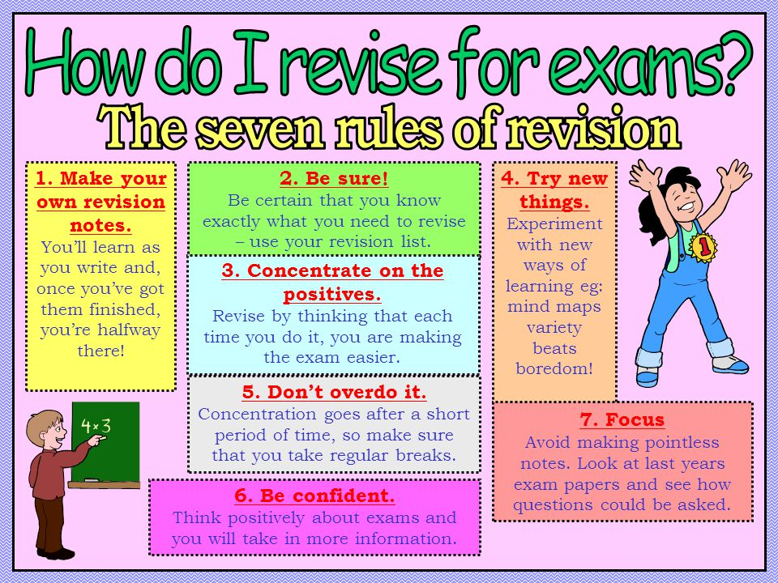
REvision
REvision
Not everyone revises in the same way. Now is the time to find out how you best revise. See below for some key tips.
Mind maps, past paper questions, flash cards, writing songs, visual note taking, recording yourself, look cover write check, get someone to test you, write tables, etc…
Parent/Carer Signature to confirm you carried out revision for your assessment:
Signed……………………………………………………………… Date: ………………………….

Slide 12
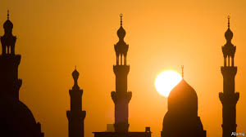
Do all women have to wear a veil?
Hijab is an Arabic word meaning barrier or partition.
In Islam, however, it has a broader meaning. It is the principle of modesty and includes behaviour as well as dress for both males and females.
The most visible form of hijab is the head covering that many Muslim women wear. Hijab however goes beyond the head scarf. In one popular school of Islamic thought, hijab refers to the complete covering of everything except the hands, face and feet in long, loose and non see-through garments.
Modesty rules are open to a wide range of interpretations. Some Muslim women wear full-body garments that only expose their eyes. Some cover every part of the body except their face and hands. Some believe only their hair or their cleavage is compulsory to hide, and others do not observe any special dress rules.
TheQur'ana few references to Muslim clothing, but prefers to point out more general principles of modest dress
What is jihad?
The Muslim concept of jihad is often confused with the idea of holy war. Jihad means 'to struggle in the way of Allah', and refers at least as much to an inner or personal spiritual struggle as it does to war and fighting.Most Muslim scholars agree there are two levels of jihad, and that of these, greater jihad is the more important.
Greater jihad
This refers to the personal spiritual struggle of every Muslim to follow the teachings of Allah in their daily lives, and includes overcoming evils such as anger, greed, pride and hatred, forgiving people who hurt them, and working for social justice.
Lesser jihad
Most Muslims are not pacifists, and believe it is justifiable to struggle to defend Islam, for justice, or in self-defence, and to use force if necessary. If all peaceful means fail, a Muslim should be ready to fight to defend the ummah against aggression, to defend the oppressed, or to combat injustice. This is lesser jihad.
Say to the believing men that they should lower their gaze and guard their modesty: that will make for greater purity for them: And Allah is well acquainted with all that they do.
24:30
RE-Asking difficult questions
In this unit you will discuss some questions that have complicated answers. There will be a focus on the religion of Islam
What is Islamophobia?
Some people have blamed all Muslims for recent terrorist attacks carried out by extreme groups who say they follow the religion of Islam.
But, many people say those terrorist groups have extreme beliefs of hatred and violence that have little to do with what most Muslims believe.
They say it is important not to blame a big group of people for what a small number of individuals have done.
Islamophobia can result in Muslims being targeted, whether in person or online.
They can be badly treated, insulted or even physically hurt.
Many people think Islamophobia is created when a person doesn't properly understand what Muslims do or believe, and that the best way to combat it is to have a better understanding of Muslims and Islam.

