Slide 1
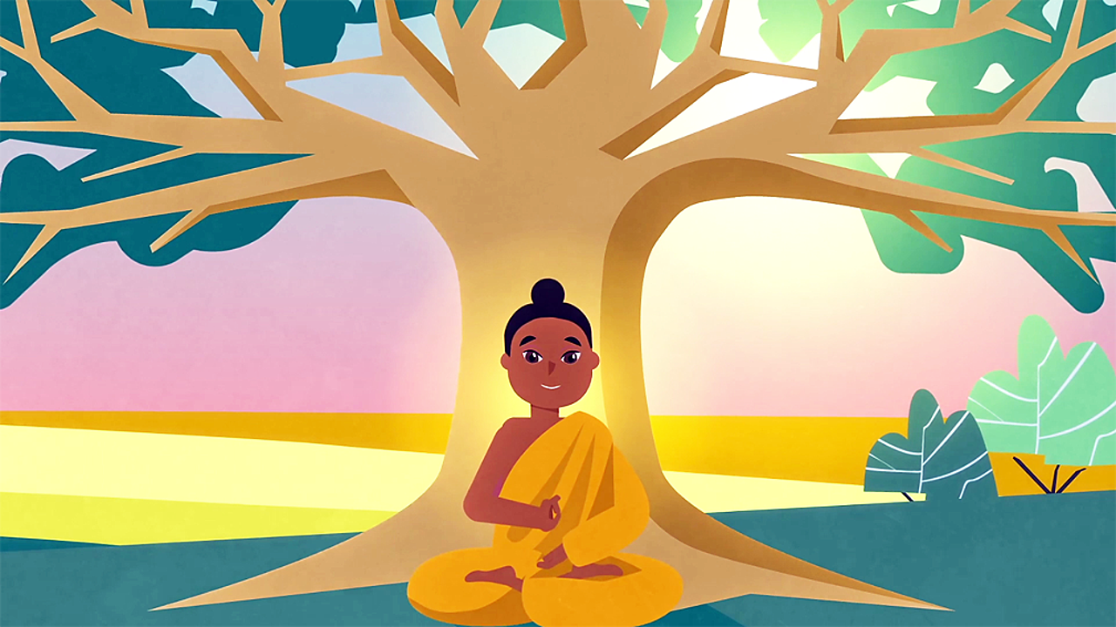
WCSA
Religious Studies
Home Learning Booklet Learning Cycle 2 Y8
Buddhism
Name: _______________________________Tutor Group: 8___
Target Grade:________ Class: 8_________
Teacher: ___________________________________

Slide 2
Keywords …. p4 Week Due: 1 Siddhartha …… p5 Week Due: 2 Eightfold path …… p6 Week Due: 3 Tipitaka Jatakas …… p7 Week Due: 4 5 moral precepts …… p8 Week Due: 5 Meditation and mindfulness…… p9 Week Due: 6 Core Buddhist beliefs …… p10 Week Due: 7 Revision…… p11 Week Due: 8
Contents
November | 25 | 26 | 27 | 28 | 29 | Teaching week 1
December | 2 | 3 | 4 | 5 | 6 | Teaching week 2
 | 9 | 10 | 11 | 12 | 13 | Teaching week 3
 | 16 | 17 | 18 | 19 | 20 | Teaching week 4
 | 23 | 24 | 25 | 26 | 27 | Christmas Break
 | 30 | 31 | 1 | 2 | 3 | Christmas Break
January | 6 | 7 | 8 | 9 | 10 | Teaching week 5
 | 13 | 14 | 15 | 16 | 17 | Teaching week 6
 | 20 | 21 | 22 | 23 | 24 | Teaching week 7
 | 27 | 28 | 29 | 30 | 31 | Assessment Week
February | 3 | 4 | 5 | 6 | 7 | Super Teach Week

Slide 3
Why is regular home learning important?
It can improve a student’s thinking and memory skills. This is vital for the new content heavy GCSEs.
It helps students to develop positive study skills and habits that will serve them well throughout life.
Home learning encourages students to use time wisely and efficiently.
It teaches students to work independently.
Home learning teaches students to take responsibility for their own work.
It allows students to review and practice what has been covered in class and consolidate their knowledge and skills.
Equally important, it helps students to get ready for the next day’s class.
It helps students learn to use resources, such as libraries, reference materials, and computer Web sites to find information.
It encourages students to explore subjects more fully than classroom time permits.
It allows students to extend their learning by applying skills to new situations.
Home learning helps parents learn more about what their children learning in school.
It allows parents to communicate with teachers about learning in order to support their children efficiently.

Slide 4
Week 1 Key word practice: Look, cover, write, check!
Nirvana | A state of bliss (enlightenment)
Dukkha | Suffering
Meditation | Guidelines for how to live life
Mandala | Patterns Buddhists use to calm their mind
Enlightenment | Understanding the nature of the world and being human
Sangha | The Buddhist community
Bikkhu/ Bikkhuni | Buddhist monk/ nun
Buddha | The enlightened one.

Slide 5
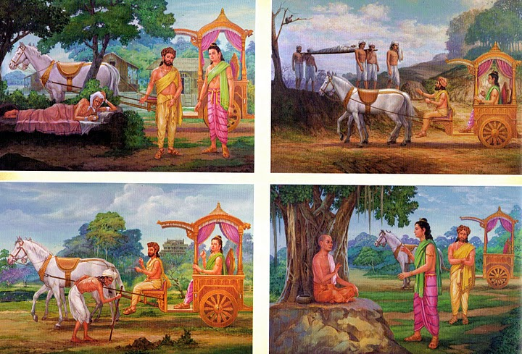
Week 2 Siddhartha
Siddhartha decided to go search for enlightenment after seeing the four sights.
He left behind his wife and child. Note down what each sight is and why it is important that Siddhartha saw them.
Teacher Signature:_______________________________________

Slide 6
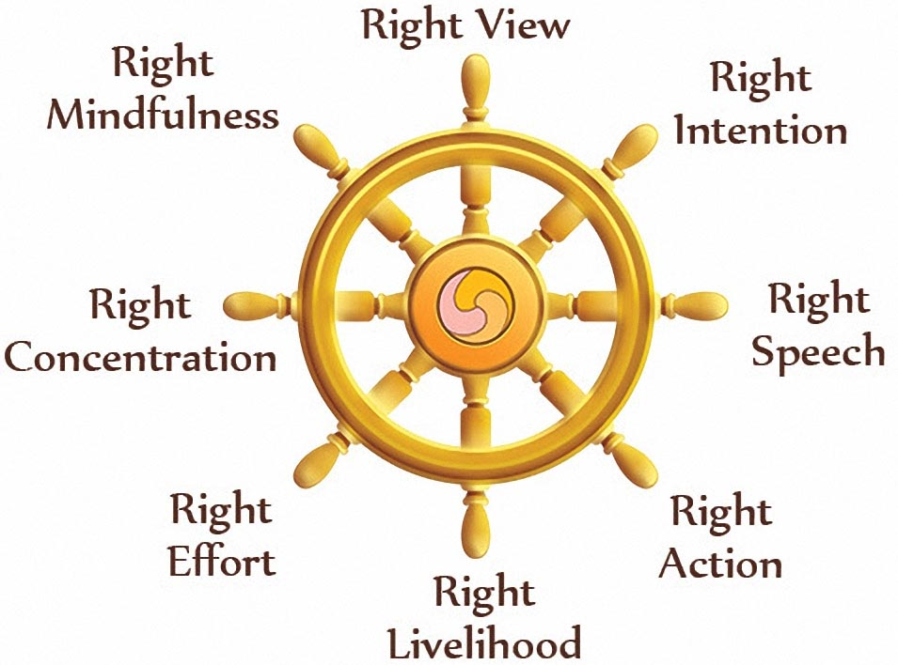
Week 3 The Noble Eightfold Path
In order to achieve enlightenment Buddhists need to follow the Eightfold Path.
Consider the parts and answer the questions below.
Which part do you think is the hardest to follow? Why?
___________________________________________________
___________________________________________________
___________________________________________________
___________________________________________________
Which do you think is most important? Why?
___________________________________________________
___________________________________________________
___________________________________________________
___________________________________________________
Are there any you don’t think should be on the list? Why?
___________________________________________________
___________________________________________________
___________________________________________________
___________________________________________________
Teacher Signature:_______________________________________

Slide 7
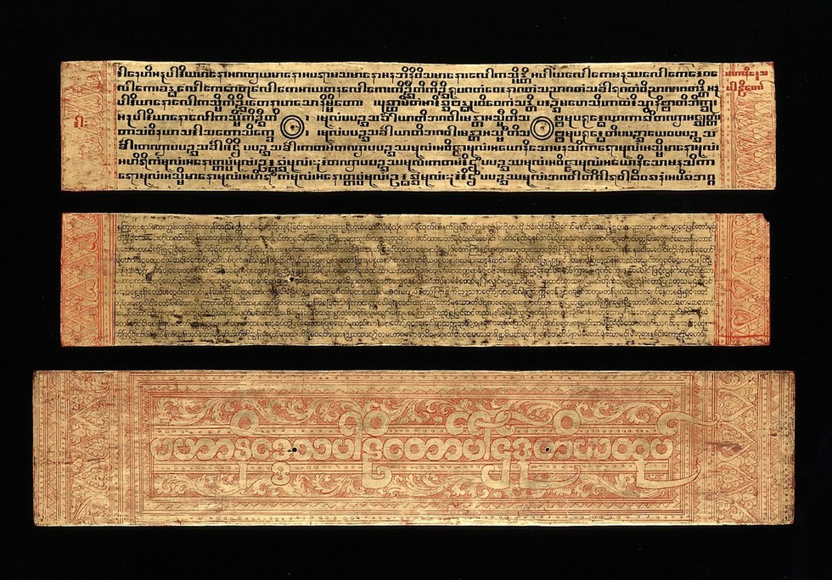
Week 4 Tipitakas
You’ve just learnt about the tipitakas (the three baskets).
The Tripitaka is organized into three sections:
Vinaya Pitaka (discipline basket), which contains rules of conduct for the community of monks and nuns.
Sutta Pitaka (sutra, or sayings, basket), which is a collection of the teachings by the Buddha and his disciples.
Abhidhamma Pitaka (higher knowledge, or teachings, basket), which is a collection of writings, songs, stories and poetry that focuses primarily on philosophy and psychology, and explains Buddhist teaching.
Which of these baskets do you think is most important? Why?
__________________________________________________________
____________________________________________________
____________________________________________________
____________________________________________________
____________________________________________________
____________________________________________________
Teacher Signature:_______________________________________

Slide 8
Week 5 Rules for life
Use the images to help you to complete the tasks at the bottom of the page.
In Buddhism there are 5 moral precepts. These are guidelines for living a good life. They include how you should treat others, animals and yourself.
Come up with 4 of your own rules for living a good life, then explain why you’ve picked the ones you have.
- ________________________________________________________________
- ________________________________________________________________
- ________________________________________________________________
- ________________________________________________________________
I chose these because : _____________________________________________ _________________________________________________________________
_________________________________________________________________
_________________________________________________________________
_________________________________________________________________
_________________________________________________________________
Teacher Signature:_______________________________________

Slide 9
Week 6 Meditation
A key aspect of Buddhism is meditation. This is done in many ways – colouring, controlled breathing, guided meditation and many others.
Spend ten minutes of quiet contemplation. You can go for a walk, colour the pattern below or just take time without any electronics on. Then write about how you felt during this time.
_______________________________________________________________________________________
_______________________________________________________________________________________
_______________________________________________________________________________________
_______________________________________________________________________________________
_______________________________________________________________________________________
_______________________________________________________________________________________
_______________________________________________________________________________________
_______________________________________________________________________________________
Teacher Signature:_______________________________________

Slide 10
Week 7 Achieving enlightenment
Next week your assessment is on whether meditation is the best way to achieve enlightenment. You need to look at both sides of the argument. Below is a list of reasons. Either label them as meditation or following the Eightfold Path.
Siddhartha meditated for years after he left. | Teaching suggests that to achieve enlightenment you need to remove suffering. | Siddhartha told everyone they needed to following the middle path
Siddhartha said Liberation is not possible without meditation. | Meditation is a great way to let go of things that are troubling you and causing suffering. | Meditation is only part of the eightfold path.
Meditation
Eightfold path
Explain your opinion on how a Buddhist can achieve enlightenment.
_______________________________________________________________________________________
_______________________________________________________________________________________
_______________________________________________________________________________________
_______________________________________________________________________________________
_______________________________________________________________________________________
_______________________________________________________________________________________
_______________________________________________________________________________________
Teacher Signature:_______________________________________
Notes:
Some people believe that only their god is the correct one. Some people believe that all gods are false and do not exist. Other people believe they are all true and all different ways to understand one thing.
About God Hindus believe that there is one eternal force called Brahman. To help Christians to understand Brahman he is represented as lots of different gods with different qualities.
Jews believe there is only one God. They called God Yahweh. They will worship Yahweh and want to have relationship with him.
Christians believe that there is only one God but that God is 3 different Persons. This belief is called the Trinity. Christians believe in the Father, the Son, who is called Jesus, and the Holy Spirit.
Muslims call God Allah. Muslims believe that there is only one God. He is not divided in any way and does not show himself in any different forms. He is one. This belief in one God is called tawhid.
Sikh believe in one supreme God called Waheguru which means supreme teacher. Waheguru can help to guide Sikhs.
Buddhists do not believe in an omnipotent God who watches over them. They do believe that there are gods in the many Buddhist heavens but they are just reincarnations of people.

Slide 11
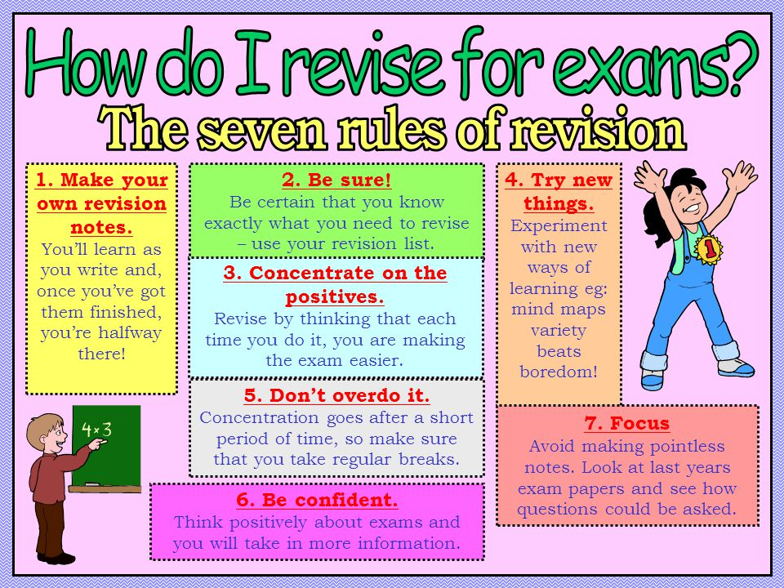
REvision
REvision
Not everyone revises in the same way. Now is the time to find out how you best revise. See below for some key tips.
Mind maps, past paper questions, flash cards, writing songs, visual note taking, recording yourself, look cover write check, get someone to test you, write tables, etc…
Parent/Carer Signature to confirm you carried out revision for your assessment:
Signed……………………………………………………………… Date: ………………………….

Slide 12
_______________________________________________________________________________________
_______________________________________________________________________________________
_______________________________________________________________________________________
_______________________________________________________________________________________
_______________________________________________________________________________________
_______________________________________________________________________________________
_______________________________________________________________________________________
____________________________________________________________________________________________________________________________________________________________________________
_______________________________________________________________________________________
_______________________________________________________________________________________
_______________________________________________________________________________________
_______________________________________________________________________________________
_______________________________________________________________________________________
_______________________________________________________________________________________
_____________________________________________________________________________________________________________________________________________________________________________
_______________________________________________________________________________________
_______________________________________________________________________________________
_______________________________________________________________________________________
_______________________________________________________________________________________
_______________________________________________________________________________________
_______________________________________________________________________________________
_______________________________________________________________________________________
_______________________________________________________________________________________
_______________________________________________________________________________________
_______________________________________________________________________________________
_______________________________________________________________________________________
_______________________________________________________________________________________
_______________________________________________________________________________________
_______________________________________________________________________________________
_______________________________________________________________________________________

Slide 13
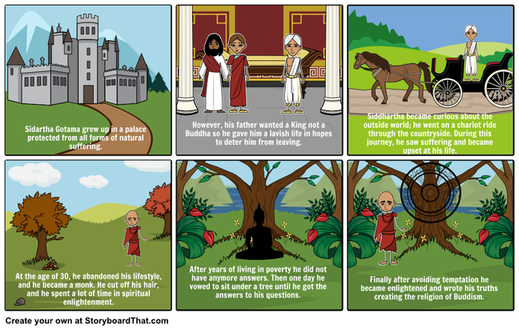
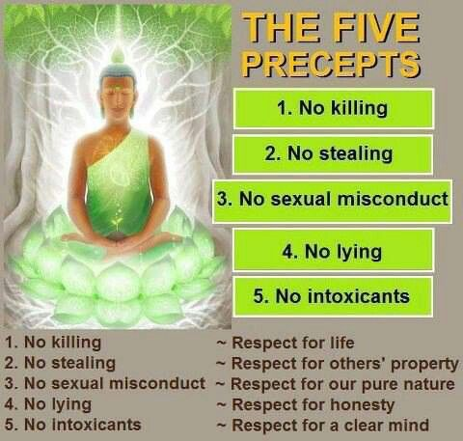
The Life of the Buddha
YEAR 8 - CYCLE 2 - KNOWLEDGE ORGANISER
RELIGIOUS STUDIES - Buddhism
KEYWORDS
Key words:
Nirvana- a state of bliss (enlightenment)
Dukkha- suffering
Five precepts- guidelines for how to live life
Meditation- process of relaxing and clearing the mind
Mandala- patterns Buddhists use to calm their mind
Enlightenment- understanding the nature of the world and being human
Sangha- the Buddhist community
Bikkhu/ Bikkhuni- Buddhist monk/ nun
Buddha- the enlightened one.
The four sights he saw were:
old age, death, disease and then a happy man who made him curious to follow his path.
CHALLENGE: Can you memorise all 5?

Slide 14
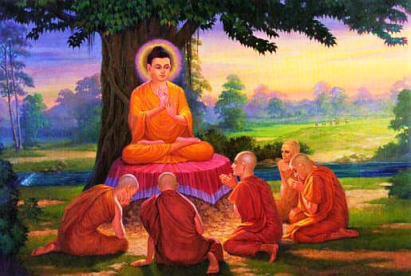
Some Buddhists use mandalas to help them to meditate
Meditation for Buddhists:
Meditation is a mental and physical course of action that a person uses to separate themselves from their thoughts and feelings in order to become fully aware.
Buddhism asks its followers to understand the world and themselves in a deep and transforming way. If they succeed, they are ‘awakened’. Meditation is one of the tools that Buddhism employs to bring this about. It already existed in the Hindu tradition, and the Buddha himself used meditation as a means to enlightenment.
Over the centuries Buddhism has evolved many different techniques: for example, mindfulness; loving-kindness and visualisation.
The purpose of meditation is to stop the mind rushing about in an aimless (or even a purposeful) stream of thoughts. People often say that the aim of meditation is to still the mind.

