Slide 1
WCSA
Religious Studies
Home Learning Book - RS Learning Cycle 2
Relationships and Families
Yr10 Home Learning Booklet
Name: _______________________________Tutor Group: 10 _
Teacher: ___________________________________

Slide 2
The Purpose of Home Learning …… p3 Keywords…… p4 To be completed Week 1 Sexual Relationships…… p5 To be completed Week 2 Revision Question…… p6 To be completed Week 3 Revision of Keywords…… p7 To be completed Week 4 Marriage…… p8 To be completed Week 5 Quotes…… p9 To be completed Week 6 Roles of men and women …. P10 To be completed Week 7 Revision…… p11-12 To be completed Week 8
Learning Cycle 2 - Contents
November | 25 | 26 | 27 | 28 | 29 | Teaching week 1
December | 2 | 3 | 4 | 5 | 6 | Teaching week 2
 | 9 | 10 | 11 | 12 | 13 | Teaching week 3
 | 16 | 17 | 18 | 19 | 20 | Teaching week 4
 | 23 | 24 | 25 | 26 | 27 | Christmas Break
 | 30 | 31 | 1 | 2 | 3 | Christmas Break
January | 6 | 7 | 8 | 9 | 10 | Teaching week 5
 | 13 | 14 | 15 | 16 | 17 | Teaching week 6
 | 20 | 21 | 22 | 23 | 24 | Teaching week 7
 | 27 | 28 | 29 | 30 | 31 | Assessment Week
February | 3 | 4 | 5 | 6 | 7 | Super Teach Week

Slide 3
Why is regular home learning important?
It can improve a student’s thinking and memory skills. This is vital for the new content heavy GCSEs.
It helps students to develop positive study skills and habits that will serve them well throughout life.
Home learning encourages students to use time wisely and efficiently.
It teaches students to work independently.
Home learning teaches students to take responsibility for their own work.
It allows students to review and practice what has been covered in class and consolidate their knowledge and skills.
Equally important, it helps students to get ready for the next day’s class.
It helps students learn to use resources, such as libraries, reference materials, and computer Web sites to find information.
It encourages students to explore subjects more fully than classroom time permits.
It allows students to extend their learning by applying skills to new situations.
Home learning helps parents learn more about what their children learning in school.
It allows parents to communicate with teachers about learning in order to support their children efficiently.

Slide 4
Knowledge
Week 1: Key Terms
Task: Using the words below match them to the correct definition.
Nuclear family, adultery, cohabitation, annulment, gender discrimination, bigamy, polygamy, procreation, heterosexual, contraception, marriage, homosexual.
_________________– Acting against someone on the basis of their gender; discrimination is usually seen as wrong and may be against the law.
__________________ – Bringing babies into the world; producing offspring.
__________________- The practice or custom of having more than one wife at a time.
__________________ – A couple living together and having a sexual relationship without being married to each other.
________________– The methods used to prevent a pregnancy from taking place.
_____________ – Voluntary sexual intercourse between a married person and someone who is not their spouse (husband or wife).
_____________ – To be sexually attracted to members of the opposite sex.
_______________ – A couple and their children regarded as a basic social unit.
_____________ – The offence of marrying someone while already married to another person.
______________– To be sexually attracted to members of the same sex.
_______________– The legal union between a man and a woman (or in some countries, including the UK, two people of the same sex) as partners in a relationship.
_____________________ - a Catholic Church ruling that a marriage was never valid.
Parent/ Carer comments:
Date: Teacher Signature:

Slide 5
Consolidation
Week 2: Sexual Relationships
In class you looked at different Christian views about sexual relationships before and outside of marriage. Using this information and internet research complete the task below.
The following are some clips that may help, they look at Christian and Islamic views.
https://www.bbc.com/bitesize/topics/z2mb4j6
https://www.bbc.com/bitesize/guides/z8kjpv4/revision/1
Task
Design a problem page for a teenage magazine that discusses sexual relationships before marriage.
Be sure to include different points of view.
Parent/ Carer comments:
Date: Teacher Signature:

Slide 6
Exam Question
Week 3: Revision
It’s super important that you have practice at writing exam answers. For a four mark question you need to make two detailed points.
There are sentence starters to help you complete the first point.
Challenge: Complete a second point
4) Explain two contrasting religious beliefs about the use of contraception.
In your answer you must refer to one or more religious traditions. (4)
_______________________________________________________________________________________
_______________________________________________________________________________________
_______________________________________________________________________________________
_______________________________________________________________________________________
_______________________________________________________________________________________
___________________________________________________________________________________
 | Description | Awarded
1 | One brief point
2 | One developed point OR Two brief points
3 | One brief and one developed point
4 | Two developed points
Parent/ Carer comments:
Date: Teacher Signature:

Slide 7
Week 4:Define the key term, then note down a religious view about it!
Key Word | Definition | Religious view
Heterosexual
Homosexual
Sex before marriage
Adultery
Contraception
Marriage
Same sex marriage
Bigamy
Procreation
Cohabitation
Divorce

Slide 8
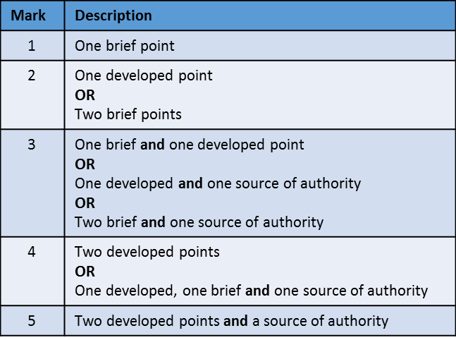
Consolidation
Week 5: Marriage
Explain two Christian beliefs about marriage. (5)
Refer to sacred writings or another source of religious belief and teaching in your answer
__________________________________________________________________________________________________________________________________________________________
_______________________________________________________________________________________________________________________________________________________________________________________________________________________________________
_______________________________________________________________________________________________________________________________________________________________________________________________________________________________________________________________________________________________________________________________________________________________________________________________________________________________________________________________________________________________________________________________________________________________________________________________________________________________________________________________________________________________________________________________________________________________________________________________________________________________________________________________________________________________________________________________________________________________________________________________________________________________________________________________________________________________________________________________________________________________________________________________________________________________________________________________________________________________________________________________________________________________________________________________________________________________________________________________________________________________________________________
Parent/ Carer comments:
Date: Teacher Signature:

Slide 9
Week 6: Key teaching revision – explain how each teaching links to the topic area.
Divorce
“What God has joined together, let no-one separate”
___________________________________________________
___________________________________________________
___________________________________________________
Marriage
“Wives, submit yourselves to your own husbands, as it is fit in the Lord. Husbands, love your wives, and be not bitter against them.”
___________________________________________________
___________________________________________________
___________________________________________________
Adultery
“God will judge the sexually immoral and adulterous.”
___________________________________________________
___________________________________________________
___________________________________________________
Remarriage
"And I say to you, whoever divorces his wife, except for immorality, and marries another woman commits adultery."
___________________________________________________
___________________________________________________
___________________________________________________

Slide 10
Consolidation
Week 7: Roles of men and women
Explain two contrasting religious teachings about the roles of men and women. (5)
Refer to sacred writings or another source of religious belief and teaching in your answer
__________________________________________________________________________________________________________________________________________________________
_______________________________________________________________________________________________________________________________________________________________________________________________________________________________________
_______________________________________________________________________________________________________________________________________________________________________________________________________________________________________________________________________________________________________________________________________________________________________________________________________________________________________________________________________________________________________________________________________________________________________________________________________________________________________________________________________________________________________________________________________________________________________________________________________________________________________________________________________________________________________________________________________________________________________________________________________________________________________________________________________________________________________________________________________________________________________________________________________________________________________________________________________________________________________________________________________________________________________________________________________________________________________________________________________________________________________________________
Parent/ Carer comments:
Date: Teacher Signature:

Slide 11
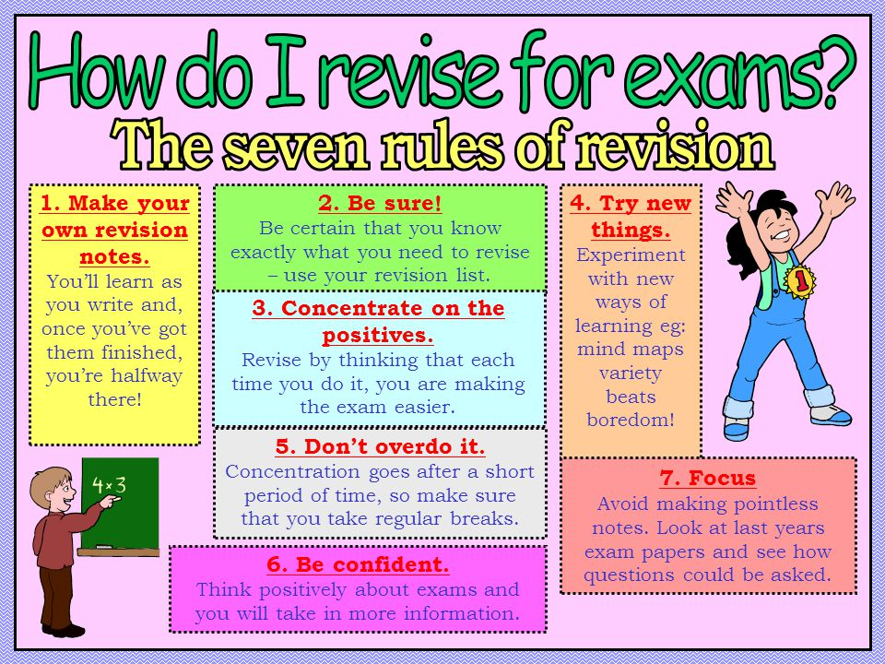
REvision
Week 8: Revision
Not everyone revises in the same way. Now is the time to find out how you best revise. See below for some key tips.
Mind maps, past paper questions, flash cards, writing songs, visual note taking, recording yourself, look cover write check, get someone to test you, write tables, etc…
Parent/Carer Signature to confirm you carried out revision for your assessment:
Signed……………………………………………………………… Date: ………………………….

Slide 12
Revision Notes

