Slide 1
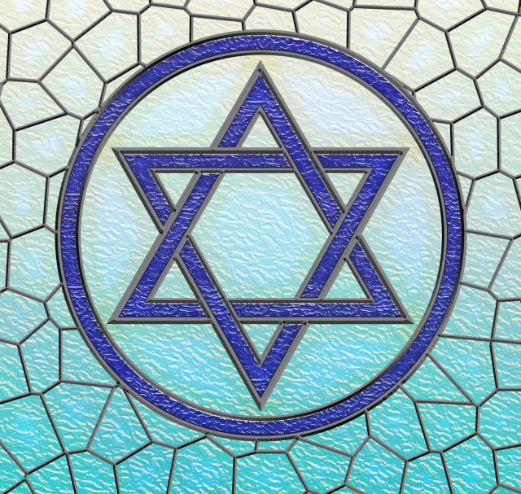
WCSA
Religious Studies
Home Learning Booklet Learning Cycle 2 Y7
Judaism
Name: _______________________________Tutor Group: 7___
Target Grade:________ Class: 7_________
Teacher: ___________________________________

Slide 2
Keywords …. p4 Week Due: 1 Moses …… p5 Week Due: 2 Passover …… p6 Week Due: 3 Rules …… p7 Week Due: 4 10 Commandments …… p8 Week Due: 5 Food laws …… p9 Week Due: 6 Synagogue …… p10 Week Due: 7 REvision…… p11 Week Due: 8
Contents
November | 25 | 26 | 27 | 28 | 29 | Teaching week 1
December | 2 | 3 | 4 | 5 | 6 | Teaching week 2
 | 9 | 10 | 11 | 12 | 13 | Teaching week 3
 | 16 | 17 | 18 | 19 | 20 | Teaching week 4
 | 23 | 24 | 25 | 26 | 27 | Christmas Break
 | 30 | 31 | 1 | 2 | 3 | Christmas Break
January | 6 | 7 | 8 | 9 | 10 | Teaching week 5
 | 13 | 14 | 15 | 16 | 17 | Teaching week 6
 | 20 | 21 | 22 | 23 | 24 | Teaching week 7
 | 27 | 28 | 29 | 30 | 31 | Assessment Week
February | 3 | 4 | 5 | 6 | 7 | Super Teach Week

Slide 3
Why is regular home learning important?
It can improve a student’s thinking and memory skills. This is vital for the new content heavy GCSEs.
It helps students to develop positive study skills and habits that will serve them well throughout life.
Home learning encourages students to use time wisely and efficiently.
It teaches students to work independently.
Home learning teaches students to take responsibility for their own work.
It allows students to review and practice what has been covered in class and consolidate their knowledge and skills.
Equally important, it helps students to get ready for the next day’s class.
It helps students learn to use resources, such as libraries, reference materials, and computer Web sites to find information.
It encourages students to explore subjects more fully than classroom time permits.
It allows students to extend their learning by applying skills to new situations.
Home learning helps parents learn more about what their children learning in school.
It allows parents to communicate with teachers about learning in order to support their children efficiently.

Slide 4
Week 1 Key word practice: Look, cover, write, check!
Torah | Jewish holy book
Covenant | A sacred promise between two groups/people
Passover | Jewish festival celebrating escape from slavery
Exodus | The escape from Egypt of the Israelites
Israelites | The ancient term used to describe Jews
Miracle | Unexplained event E.G. Burning bush
Kosher food | Food that is considered pure according to g-d
Kashrut | The Jewish food laws
Shabbat | The weekly Jewish holy day

Slide 5
Week 2 Abraham and Moses
Using the knowledge organiser at the back or research online note down 3 key facts about Moses and 3 key facts about Abraham.
Abraham | Moses
1 | 1
2 | 2
3 | 3
Teacher Signature:_______________________________________

Slide 6
Week 3 Exodus from Egypt
Read through the story of Exodus below. Highlight information you think will be important when we look at how Jews celebrate this.
After the Hebrews went to Egypt to get food, the old Pharaoh died, and a new Pharaoh came to power and made each Hebrew a slave. The Pharaoh made the Hebrews work very hard and told his soldiers to throw their babies into the Nile River. One baby, Moses, was put in a reed basket set adrift on the Nile. He was later rescued by an Egyptian princess, grew up in Pharaoh's palace, and later killed an Egyptian slaveowner. Moses escaped from Egypt and lived away from his people in Midian. He lived with Jethro, his father-in-law.
One day, while Moses was tending his flocks, God appeared in a burning bush to Moses and instructed him to lead the Israelites out of Egypt. As Moses had no confidence in doing this, God gives him his brother Aaron to help him. Aaron was a good talker and helped Moses speak to the Pharaoh.
When he returned to Egypt, Moses asked the Pharaoh to let the Israelites go, but the Pharaoh refused. Through God's power, Moses causes ten plagues to come on Egypt.
The last plague was the death of all the firstborns in Egypt. Only the Israelites' firstborns were spared, as they had the blood of a young lamb on their door, so God did not let the Angel of Death enter their houses (12:23). The Pharaoh finally decided to let the Israelites go.
While the Israelites were crossing the Red Sea, the Pharaoh changed
his mind and decided to pursue them with his troops. The Israelites passed safely as Moses parted the Sea with his staff by God's power. Once the Hebrews all passed the sea closed, leaving all the Pharaoh's troops to drown.
Teacher Signature:_______________________________________

Slide 7
Week 4 Rules
Note down 5 rules from your house, school, society or a club you belong to. Then state why it important that this rule is followed
Rule | Importance
1
2
3
4
5
Teacher Signature:_______________________________________

Slide 8
Week 5 – Ten Commandments consolidation
What are the arguments for and against factory farming. What is your opinion?
Explain two ways the Ten Commandments influence Jews today.
_______________________________________________________________________________________
_______________________________________________________________________________________
_______________________________________________________________________________________
_______________________________________________________________________________________
_______________________________________________________________________________________
_______________________________________________________________________________________
_______________________________________________________________________________________
_______________________________________________________________________________________
_______________________________________________________________________________________
_______________________________________________________________________________________ _______________________________________________________________________________________ _______________________________________________________________________________________ _______________________________________________________________________________________
Description | Awarded
Describe arguments for or against
Describe arguments for and against
Explain arguments for and against
Explain arguments in detail
One way they influence Jews is … (show them how to worship)
For example …
Another way they influence Jews today is … (they show them how to act)
For example …
Teacher Signature:_______________________________________

Slide 9
Week 6 Jewish food laws
Below you need to imagine you have a Jewish person who follows all the food laws coming to dinner.
Plan out a 3 course meal you can do them. Extension – add images and ingredients.
If you need help try this video - https://www.youtube.com/watch?v=ifKFC4jYqS8
Starter
Main
Dessert
Explain why you picked your ingredients.
_______________________________________________________________________________________
_______________________________________________________________________________________
_______________________________________________________________________________________
_______________________________________________________________________________________
_______________________________________________________________________________________
Teacher Signature:_______________________________________
Notes:
Some people believe that only their god is the correct one. Some people believe that all gods are false and do not exist. Other people believe they are all true and all different ways to understand one thing.
About God Hindus believe that there is one eternal force called Brahman. To help Christians to understand Brahman he is represented as lots of different gods with different qualities.
Jews believe there is only one God. They called God Yahweh. They will worship Yahweh and want to have relationship with him.
Christians believe that there is only one God but that God is 3 different Persons. This belief is called the Trinity. Christians believe in the Father, the Son, who is called Jesus, and the Holy Spirit.
Muslims call God Allah. Muslims believe that there is only one God. He is not divided in any way and does not show himself in any different forms. He is one. This belief in one God is called tawhid.
Sikh believe in one supreme God called Waheguru which means supreme teacher. Waheguru can help to guide Sikhs.
Buddhists do not believe in an omnipotent God who watches over them. They do believe that there are gods in the many Buddhist heavens but they are just reincarnations of people.

Slide 10
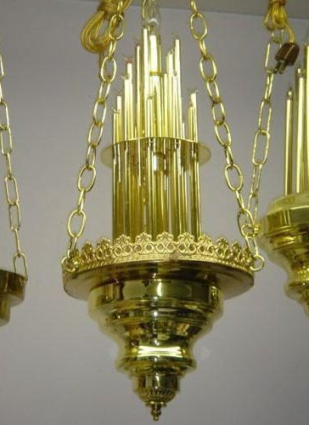
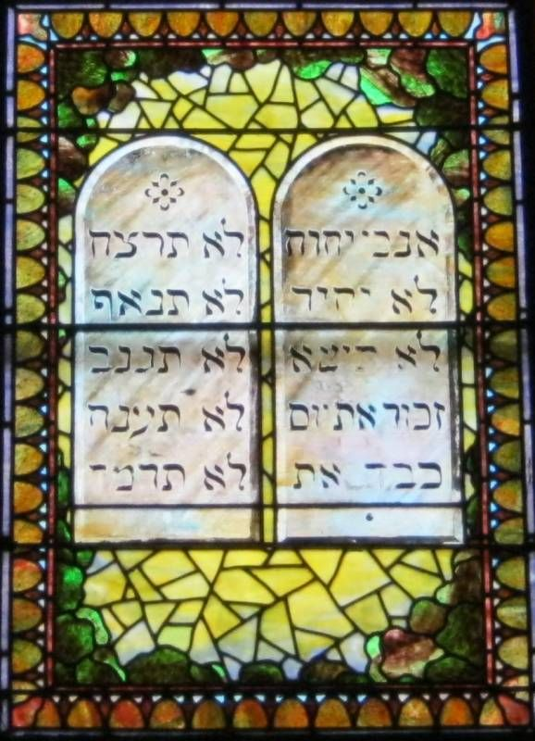
Week 7 Synagogue
Jews worship in a synagogue – we will look at what is in a synagogue and it’s importance next week. Look at the images of some parts of the synagogue and guess what you think they are, and why they are in a synagogue.
_____________________________________________________
_____________________________________________________
_____________________________________________________
_____________________________________________________
_____________________________________________________
_____________________________________________________
_____________________________________________________
_____________________________________________________
_____________________________________________________
_____________________________________________________
_____________________________________________________
_____________________________________________________
_____________________________________________________
_____________________________________________________
_____________________________________________________
_____________________________________________________
_____________________________________________________
_____________________________________________________
_____________________________________________________
_____________________________________________________
_____________________________________________________
_____________________________________________________
_____________________________________________________
_____________________________________________________
Teacher Signature _______________________

Slide 11
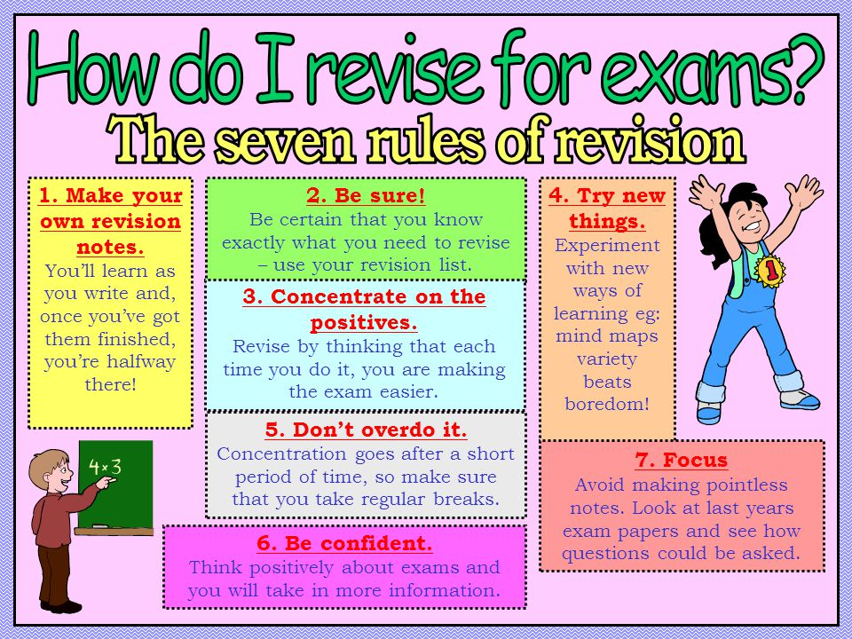
REvision
Week 8 REvision
Not everyone revises in the same way. Now is the time to find out how you best revise. See below for some key tips.
Mind maps, past paper questions, flash cards, writing songs, visual note taking, recording yourself, look cover write check, get someone to test you, write tables, etc…
Parent/Carer Signature to confirm you carried out revision for your assessment:
Signed……………………………………………………………… Date: ………………………….

Slide 12
_______________________________________________________________________________________
_______________________________________________________________________________________
_______________________________________________________________________________________
_______________________________________________________________________________________
_______________________________________________________________________________________
_______________________________________________________________________________________
_______________________________________________________________________________________
____________________________________________________________________________________________________________________________________________________________________________
_______________________________________________________________________________________
_______________________________________________________________________________________
_______________________________________________________________________________________
_______________________________________________________________________________________
_______________________________________________________________________________________
_______________________________________________________________________________________
_____________________________________________________________________________________________________________________________________________________________________________
_______________________________________________________________________________________
_______________________________________________________________________________________
_______________________________________________________________________________________
_______________________________________________________________________________________
_______________________________________________________________________________________
_______________________________________________________________________________________
_______________________________________________________________________________________
_______________________________________________________________________________________
_______________________________________________________________________________________
_______________________________________________________________________________________
_______________________________________________________________________________________
_______________________________________________________________________________________
_______________________________________________________________________________________
_______________________________________________________________________________________
_______________________________________________________________________________________

Slide 13
RELIGIOUS STUDIES JUDAISM
YEAR 7 - CYCLE 2 - KNOWLEDGE ORGANISER
CHALLENGE: Can you memorise all 10?
EXTENSION: Can you memorise the order?
MOSES the law bringer
Moses is another key figure in Judaism. He was born an Israelite (modern day Jew), but to save his life, his mother allowed him to be raised an Egyptian. He grew up to understand he was not Egyptian, left in disgrace after killing an Egyptian, and met G-d in the form of a burning bush. G-d told him to lead his people (the Israelites) out of slavery and into a Promised Land (as promised to Abraham years before). After 10 plagues sent by G-d to punish the Egyptians they finally were freed. G-d met Moses again on a mountain and gave him new laws for the newly freed people. The most commonly known are the 10 Commandments. To this day they are followed by many Jewish people in some way or another. They really do dictate how they live and so are central to the Jewish faith and pleasing G-d!
KEYWORDS
Torah – Jewish Holy Book
Covenant – a sacred promise between two groups/people
Passover – Jewish festival celebrating escape from slavery
Exodus – the escape from Egypt of the Israelites
Israelites – the ancient term used to describe Jews
Miracle – unexplained event e.g. burning bush
Kosher food – food that is considered pure according to G-d
Kashrut – the Jewish food laws
Shabbat – the weekly Jewish holy day
ABRAHAM the Father of Israel
Abraham is known as the ‘Father of Israel’ because G-d made a covenant with him about the future Israelites/Jewish people. He said to Abraham that if he loved and obeyed G-d, and they circumcised every new born boy, then G-d would give them a land of their own and that from him would come a nation that numbered as many ‘as the stars in the sky’. He also promised that Abraham would have a son with his wife Sarai, even though they were both very old now. They had a son called Isaac and G-d decided to test Abraham’s faith by asking him to sacrifice Isaac to G-d. Abraham passed the test, with no harm coming to Isaac, showing Jewish people that God loves obedient people who will do as he asks. They also still pray and wait for the covenant promises made with Abraham to be fulfilled.

Slide 14
PASSOVER or PESACH FESTIVAL
Passover or Pesach is a major Jewish holiday and one of the most widely celebrated Jewish holidays. In the Book of Exodus, G-d helped the Israelites escape from slavery in ancient Egypt by inflicting ten plagues upon the Egyptians before the Pharaoh would release the Israelite slaves. The last of the plagues was the death of the Egyptian first-born. The Israelites were instructed to mark the doorposts of their homes with the blood of a slaughtered spring lamb and, upon seeing this, the spirit of the Lord knew to pass over the first-born in these homes, hence the English name of the holiday. This meal is repeated every Passover and is outlined in more detail above.
The word kosher means to be pure, proper, or suitable for consumption. The laws that provide the foundation for a kosher diet are collectively referred to as kashrut and are found within the Torah, the Jewish holy book. Instructions for how to follow these laws are passed down through families.
Kosher dietary laws are detailed and provide a clear set of rules that say which foods are allowed or forbidden but also describe how allowed foods must be produced, processed, and prepared before they can be eaten or drunk.
Observant Jews should only eat meat or poultry that has been killed in the approved way, called shechita. This is done by slitting the throat of the animal and causes the animal least pain.
Many Jews will not mix meat and dairy in the same meal because of Torah teachings. They will also have sperate food preparation areas in their homes to ensure the same.
JEWISH FOOD LAWS

